Slide 2
Quan tam
1>Create Tables,drop
2>Data type
3>IDENTITY(so star, so + up):auto dem
4>foreign key
5> Globally Unique Identifiers
6>Unique(phan tu dung cho create table chi co cac so khac nhau)
7>Column Nullability
8>Check(k.tra),default(mac dinh)
9>Not null
10>Summary

Slide 3
Objectives
List SQL Server 2012 data types
Describe the procedure to create, modify, and drop tables in an SQL Server database
Describe the procedure to add, modify, and drop columns in a table

Slide 4
Introduction
One of the most important types of database objects in SQL Server 2012 is a table.
Tables in SQL Server 2012 contain data in the form of rows and columns.
Each column may have data of a specific type and size.

Slide 5
Data Type
A data type is an attribute that specifies the type of data an object can hold, such as numeric data, character data, monetary data, and so on.
A data type also specifies the storage capacity of an object.
Once a column has been defined to store data belonging to a particular data type, data of another type cannot be stored in it.
In this manner, data types enforce data integrity.
Hence, if an attempt is made to enter character data into an integer column, it will not succeed.

Slide 6
Different Kinds of Data Types 1-6
SQL Server 2012 supports three kinds of data types:
System data types
Alias data types
User-defined types
These are provided by SQL Server 2012.
These are based on the system-supplied data types.
These are created using programming languages supported by the .NET Framework, which is a software framework developed by Microsoft.
One of the typical uses of alias data types is when more than one table stores the same type of data in a column and has similar characteristics such as length, nullability, and type.
In such cases, an alias data type can be created that can be used commonly by all these tables.

Slide 7
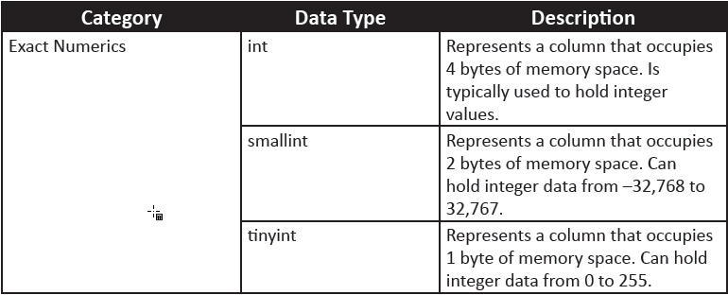
Different Kinds of Data Types 2-6
Following table shows various data types in SQL Server 2012 along with their categories and description:

Slide 8
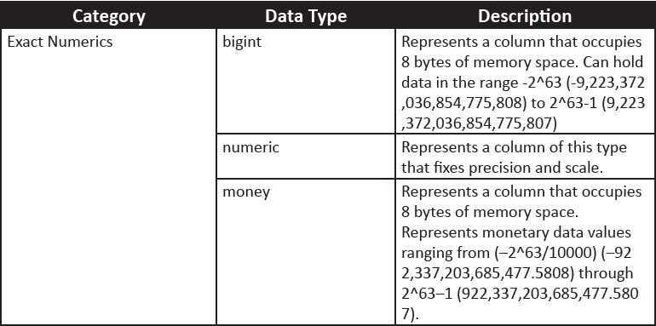
Different Kinds of Data Types 3-6

Slide 9
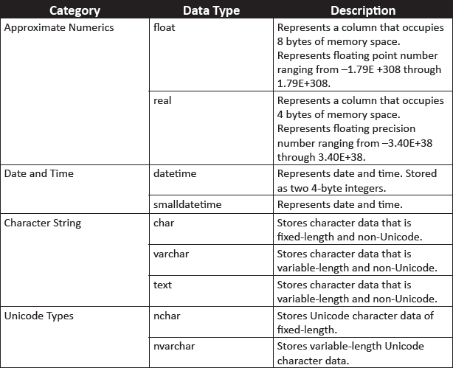
Different Kinds of Data Types 4-6

Slide 10
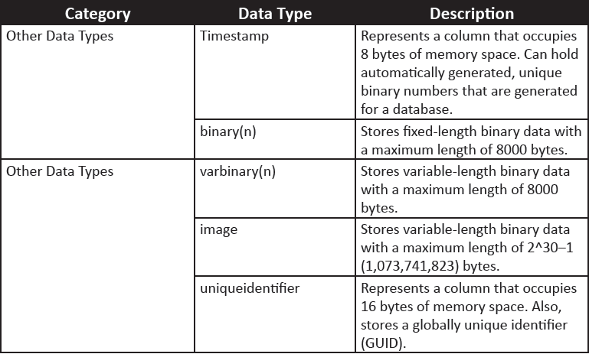
Different Kinds of Data Types 5-6

Slide 11
Different Kinds of Data Types 6-6
Alias data types can be created using the CREATE TYPE statement.
The syntax for the CREATE TYPE statement is as follows:
Syntax:
CREATE TYPE[ schema_name.] type_name{FROM base_type[(
precision[,scale])][NULL|NOT NULL]}[;]
where,
schema_name: identifies the name of the schema in which the alias data type is being created.
type_name: identifies the name of the alias type being created.
base_type: identifies the name of the system-defined data type based on which the alias data type is being created.
precision and scale: specify the precision and scale for numeric data.
NULL|NOT NULL: specifies whether the data type can hold a null value or not.
Following code snippet shows how to create an alias data type named usertype using the CREATE TYPE statement:
CREATE TYPE usertype FROM varchar(20) NOT NULL

Slide 12
Creating Tables 1-2
The CREATE TABLE statement is used to create tables in SQL Server 2012.
The syntax for CREATE TABLE statement is as follows:
Syntax:
CREATE TABLE [database_name. [schema_name].| schema_name.]table_name
([<column_name>] [data_type] Null/Not Null,)
ON [filegroup | “default”]
GO
where,
database_name: is the name of the database in which the table is created.
table_name: is the name of the new table. table_name can be a maximum of 128 characters.
column_name: is the name of a column in the table. column_name can be up to 128 characters. column_name are not specified for columns that are created with a timestamp data type. The default column name of a timestamp column is timestamp.
data_type: It specifies data type of the column.

Slide 13
Creating Tables 2-2
Following code snippet demonstrates creation of a table named dbo.Customer_1:
CREATE TABLE [dbo].[Customer_1](
[Customer_id number] [numeric](10, 0) NOT NULL,
[Customer_name] [varchar](50) NOT NULL)
ON [PRIMARY]
GO

Slide 14
Modifying Tables 1-2
The ALTER TABLE statement is used to modify a table definition by altering, adding, or dropping columns and constraints, reassigning partitions, or disabling or enabling constraints and triggers.
The syntax for ALTER TABLE statement is as follows:
Syntax:
ALTER TABLE [[database_name. [schema_name].| schema_name.]table_name
ALTER COLUMN ([<column_name>] [data_type] Null/Not Null,);
| ADD ([<column_name>] [data_type] Null/Not Null,);
| DROP COLUMN ([<column_name>];
where,
ALTER COLUMN: specifies that the particular column is to be changed or modified.
ADD: specifies that one or more column definitions are to be added.
DROP COLUMN ([<column_name>]: specifies that column_name is to be removed from the table.

Slide 15
Modifying Tables 2-2
Following code snippet demonstrates altering the Customer_id column:
USE [CUST_DB]
ALTER TABLE [dbo].[Customer_1]
ALTER Column [Customer_id number] [numeric](12, 0) NOT NULL;
Following code snippet demonstrates adding the Contact_number column:
USE [CUST_DB]
ALTER TABLE [dbo].[Table_1]
ADD [Contact_number] [numeric](12, 0) NOT NULL;
Following code snippet demonstrates dropping the Contact_number column:
USE [CUST_DB]
ALTER TABLE [dbo].[Table_1]
DROP COLUMN [Contact_name];
Under certain conditions, columns cannot be dropped, such as, if they are used in a CHECK, FOREIGN KEY, UNIQUE, or PRIMARY KEY constraint, associated with a DEFAULT definition, and so forth.

Slide 16
Dropping Tables
The DROP TABLE statement removes a table definition, its data, and all associated objects such as indexes, triggers, constraints, and permission specifications for that table.
The syntax for DROP TABLE statement is as follows:
Syntax:
DROP TABLE <Table_Name>
where,
<Table_Name>: is the name of the table to be dropped.
Following code snippet demonstrates how to drop a table:
USE [CUST_DB]
DROP TABLE [dbo].[Table_1]

Slide 17
Data Modification Statements 1-4
The statements used for modifying data are INSERT, UPDATE, and DELETE statements.
These are explained as follows:
INSERT Statement
The INSERT statement adds a new row to a table.
The syntax for INSERT statement is as follows:
Syntax:
INSERT [INTO] <Table_Name>
VALUES <values>
where,
<Table_Name>: is the name of the table in which row is to be inserted.
[INTO]: is an optional keyword used between INSERT and the target table.
<Values>: specifies the values for columns of the table.

Slide 18
Data Modification Statements 2-4
Following code snippet demonstrates adding a new row to the Table_2 table:
USE [CUST_DB]
INSERT INTO [dbo].[Table_2] VALUES (101, 'Richard Parker', 'Richy')
GO
The outcome of this will be that one row with the given data is inserted into the table.
UPDATE Statement
The UPDATE statement modifies the data in the table.
The syntax for UPDATE statement is as follows:
Syntax:
UPDATE <Table_Name>
SET <Column_Name = Value>
[WHERE <Search condition>]
where,
<Table_Name>: is the name of the table where records are to be updated.
<Column_Name>: is the name of the column in the table in which record is to be updated.

Slide 19
Data Modification Statements 3-4
<Value>: specifies the new value for the modified column.
<Search condition>: specifies the condition to be met for the rows to be deleted.
Following code snippet demonstrates the use of the UPDATE statement to modify the value in column Contact_number:
USE [CUST_DB]
UPDATE [dbo].[Table_2] SET Contact_number = 5432679 WHERE Contact_name LIKE 'Richy'
GO
Following figure shows the output of UPDATE statement:

Slide 20
Data Modification Statements 4-4
DELETE Statement
The DELETE statement removes rows from a table.
The syntax for DELETE statement is as follows:
Syntax:
DELETE FROM <Table_Name>
[WHERE <Search condition>]
where,
<Table_Name>: is the name of the table from which the records are to be deleted.
The WHERE clause is used to specify the condition. If WHERE clause is not included in the DELETE statement, all the records in the table will be deleted.
Following code snippet demonstrates how to delete a row from the Customer_2 table whose Contact_number value is 5432679:
USE [CUST_DB]
DELETE FROM [dbo].[Customer_2] WHERE Contact_number = 5432679
GO

Slide 21
Column Nullability 1-2
The nullability feature of a column determines whether rows in the table can contain a null value for that column.
In SQL Server, a null value is not same as zero, blank, or a zero length character string (such as ' '). For example, a null value in the Color column of the Production.
Product table of the AdventureWorks2012 database does not mean that the product has no color; it just means that the color for the product is unknown or has not been set.
Nullability of a column can be defined either when creating a table or modifying a table.
The NULL keyword is used to indicate that null values are allowed in the column, and the NOT NULL keywords are used to indicate that null values are not allowed.

Slide 22
Column Nullability 2-2
When inserting a row, if no value is given for a nullable column, then, SQL Server automatically gives it a null value unless the column has been given a default definition.
It is also possible to explicitly enter a null value into a column regardless of what data type it is or whether it has a default associated with it.
Making a column non-nullable enforces data integrity by ensuring that the column contains data in every row.
In the following code snippet, the CREATE TABLE statement uses the NULL and NOT NULL keywords with column definitions:
USE [CUST_DB]
CREATE TABLE StoreDetails ( StoreID int NOT NULL, Name varchar(40) NULL)
GO
The result of the code is that the StoreDetails table is created with StoreID and Name columns added to the table.

Slide 23
DEFAULT Definition 1-3
A DEFAULT definition can be given for the column to assign it as a default value if no value is given at the time of creation.
For example, it is common to specify zero as the default for numeric columns or 'N/A' or 'Unknown' as the default for string columns when no value is specified.
A DEFAULT definition for a column can be created at the time of table creation or added at a later stage to an existing table.
When a DEFAULT definition is added to an existing column in a table, SQL Server applies the new default values only to newly added rows of data.

Slide 24
DEFAULT Definition 2-3
In the following code snippet, the CREATE TABLE statement uses the DEFAULT keyword to define the default value for Price:
USE [CUST_DB]
CREATE TABLE StoreProduct( ProductID int NOT NULL, Name varchar(40) NOT NULL, Price money NOT NULL DEFAULT (100))
GO
When a row is inserted using a statement as shown in the following code snippet, the value of Price will not be blank; it will have a value of 100.00 even though a user has not entered any value for that column.
USE [CUST_DB]
INSERT INTO dbo.StoreProduct (ProductID, Name) VALUES (111, 'Rivets')
GO

Slide 25
DEFAULT Definition 3-3
Following figure shows the output, where though values are added only to the ProductID and Name columns, the Price column will still show a value of 100.00.
This is because of the DEFAULT definition.
The following cannot be created on columns with DEFAULT definitions:
A timestamp data type
An IDENTITY or ROWGUIDCOL property
An existing default definition or default object

Slide 26
IDENTITY Property 1-4
The IDENTITY property of SQL Server is used to create identifier columns that can contain auto-generated sequential values to uniquely identify each row within a table.
An identity column is often used for primary key values. The characteristics of the IDENTITY property are as follows:
A column having IDENTITY property need not have a seed and increment value specified. If they are not specified, a default value of 1 will be used for both.
A table cannot have more than one column with IDENTITY property.
The identifier column in a table must not allow null values and must not contain a DEFAULT definition or object.
When IDENTITY_INSERT is ON, INSERT statements must supply a value.
Columns defined with IDENTITY property cannot have their values updated.
The values can be explicitly inserted into the identity column of a table only if the IDENTITY_INSERT option is set ON.
A column having IDENTITY property must be defined using one of the following data types: decimal, int, numeric, smallint, bigint, or tinyint.

Slide 27
IDENTITY Property 2-4
Once the IDENTITY property has been set, retrieving the value of the identifier column can be done by using the IDENTITYCOL keyword with the table name in a SELECT statement.
To know if a table has an IDENTITY column, the OBJECTPROPERTY() function can be used.
To retrieve the name of the IDENTITY column in a table, the COLUMNPROPERTY function is used.
The syntax to add a IDENTITY property while creating a table is as follows:
Syntax:
CREATE TABLE <table_name> (column_name data_type [ IDENTITY
[(seed_value, increment_value)]] NOT NULL )
where,
seed_value: is the seed value from which to start generating identity values.
increment_value: is the increment value by which to increase each time.

Slide 28
IDENTITY Property 3-4
Following code snippet demonstrates the use of IDENTITY property:
USE [CUST_DB]
GO
CREATE TABLE HRContactPhone ( Person_ID int IDENTITY(500,1) NOT NULL, MobileNumber bigint NOT NULL )
GO
HRContactPhone is created as a table with two columns in the schema Person that is available in the CUST_DB database.
The Person_ID column is an identity column.
The seed value is 500, and the increment value is 1.
While inserting rows into the table, if IDENTITY_INSERT is not turned on, then, explicit values for the IDENTITY column cannot be given.

Slide 29
IDENTITY Property 4-4
Instead, statements similar to the following code snippet can be given:
USE [CUST_DB]
INSERT INTO HRContactPhone (MobileNumber) VALUES(983452201)
INSERT INTO HRContactPhone (MobileNumber) VALUES(993026654)
GO
Following figure shows the output where IDENTITY property is incrementing Person_ID column values:

Slide 30
Globally Unique Identifiers 1-3
Only one identifier column and one globally unique identifier column can be created for each table.
To create and work with globally unique identifiers, a combination of ROWGUIDCOL, uniqueidentifier data type, and NEWID function are used.
Values for a globally unique column are not automatically generated.
One has to create a DEFAULT definition with a NEWID() function for a uniqueidentifier column to generate a globally unique value.
In addition to the IDENTITY property, SQL Server also supports globally unique identifiers.

Slide 31
Globally Unique Identifiers 2-3
The column can be referenced in a SELECT list by using the ROWGUIDCOL keyword.
The NEWID() function creates a unique identifier number which is a 16-byte binary string.
To know whether a table has a ROWGUIDCOL column, the OBJECTPROPERTY function is used.
The COLUMNPROPERTY function is used to retrieve the name of the ROWGUIDCOL column.

Slide 32
Globally Unique Identifiers 3-3
Following code snippet demonstrates how to CREATE TABLE statement to create the EMPCellularPhone table.
The Person_ID column automatically generates a GUID for each new row added to the table.
USE [CUST_DB]
CREATE TABLE EMP_CellularPhone( Person_ID uniqueidentifier DEFAULT NEWID() NOT NULL, PersonName varchar(60) NOT NULL)
GO
Following code snippet adds a value to PersonName column:
USE [CUST_DB]
INSERT INTO EMP_CellularPhone(PersonName) VALUES ('William Smith')
SELECT * FROM EMP_CellularPhone
GO
Following figure shows the output where a unique identifier is displayed against a specific PersonName:

Slide 33
Constraints
A constraint is a property assigned to a column or set of columns in a table to prevent certain types of inconsistent data values from being entered.
Constraints are used to apply business logic rules and enforce data integrity.
Constraints can be created when a table is created or added at a later stage using the ALTER TABLE statement.
Constraints can be categorized as column constraints and table constraints.
Table constraints must be used when more than one column is included in a constraint.
A column constraint is specified as part of a column definition and applies only to that column.
A table constraint can apply to more than one column in a table and is declared independently from a column definition. .
SQL Server supports the following types of constraints:
PRIMARY KEY
UNIQUE
FOREIGN KEY
CHECK
NOT NULL

Slide 34
PRIMARY KEY 1-3
A table typically has a primary key comprising a single column or combination of columns to uniquely identify each row within the table.
The PRIMARY KEY constraint is used to create a primary key and enforce integrity of the entity of the table.
Only one primary key constraint can be created per table.
Two rows in a table cannot have the same primary key value and a column that is a primary key cannot have NULL values.
The syntax to add a primary key while creating a table is as follows:
Syntax:
CREATE TABLE <table_name> ( Column_name datatype PRIMARY KEY [
column_list] )

Slide 35
PRIMARY KEY 2-3
Following code snippet demonstrates how to create a table EMPContactPhone to store the contact telephone details of a person.
Since the column EMP_ID must be a primary key for identifying each row uniquely, it is created with the primary key constraint.
USE [CUST_DB]
CREATE TABLE EMPContactPhone ( EMP_ID int PRIMARY KEY, MobileNumber bigint, ServiceProvider varchar(30), LandlineNumber bigint)
GO
An alternative approach is to use the CONSTRAINT keyword. The syntax is as follows:
Syntax:
CREATE TABLE <table_name> (<column_name> <datatype> [, column_list]
CONSTRAINT constraint_name PRIMARY KEY)

Slide 36
PRIMARY KEY 3-3
Having created a primary key for EMP_ID, a query is written to insert rows into the table with the statements shown in the following code snippet:
USE [CUST_DB]
INSERT INTO dbo.EMPContactPhone values (101, 983345674,'Hutch', NULL)
INSERT INTO dbo.EMPContactPhone values (102, 989010002,'Airtel', NULL)
GO
The first statement shown in the code snippet is executed successfully but the next INSERT statement will fail because the value for EMP_ID is duplicate as shown in the following figure:
The output is shown in the following figure:

Slide 37
UNIQUE 1-2
A UNIQUE constraint is used to ensure that only unique values are entered in a column or set of columns.
UNIQUE constraints allow null values.
A single table can have more than one UNIQUE constraint.
The syntax to create UNIQUE constraint is as follows:
Syntax:
CREATE TABLE <table_name> ([column_list ] <column_name> <data_type> UNIQUE [ column_list])
Following code snippet demonstrates how to make the MobileNumber and LandlineNumber columns as unique:
USE [CUST_DB]
GO
CREATE TABLE EMP_ContactPhone(Person_ID int PRIMARY KEY, MobileNumber bigint UNIQUE,ServiceProvider varchar(30),LandlineNumber bigint UNIQUE)

Slide 38
UNIQUE 2-2
Following code snippet demonstrates how to insert a row into the table:
USE [CUST_DB]
INSERT INTO EMP_ContactPhone values (111, 983345674, 'Hutch', NULL)
INSERT INTO EMP_ContactPhone values (112, 983345674, 'Airtel', NULL)
GO
UNIQUE constraints check only for the uniqueness of values but do not prevent null entries.
The second INSERT statement will fail because the value for MobileNumber is a duplicate as shown in the following figure:
This is because the column MobileNumber is defined to be unique and disallows duplicate values. The output is shown in the following figure:

Slide 39
FOREIGN KEY 1-2
A foreign key in a table is a column that points to a primary key column in another table.
Foreign key constraints are used to enforce referential integrity.
The syntax for foreign key is as follows:
Syntax:
CREATE TABLE <table_name1>([ column_list,] <column_name> <datatype>
FOREIGN KEY REFERENCES <table_name> (pk_column_name> [, column_list])
where,
table_name: is the name of the table from which to reference primary key.
<pk_column_name>: is the name of the primary key column.
Following code snippet demonstrates how to create a foreign key constraint:
USE [CUST_DB]
GO
CREATE TABLE EMP_PhoneExpenses ( Expense_ID int PRIMARY KEY, MobileNumber bigint FOREIGN KEY REFERENCES EMP_ContactPhone (MobileNumber), Amount bigint)

Slide 40
FOREIGN KEY 2-2
A row is inserted into the table such that the mobile number is the same as one of the mobile numbers in EMP_ContactPhone.
The command that will be written is shown in the following code snippet:
INSERT INTO dbo.EMP_PhoneExpenses values(101, 993026654, 500)
SELECT * FROM dbo.EMP_PhoneExpenses
The error message of the code snippet is shown in the following figure:
If there is no key in the referenced table having a value that is being inserted into the foreign key, the insertion will fail as shown in the figure.
It is, however, possible to add NULL value into a foreign key column.

Slide 41
CHECK 1-2
A CHECK constraint limits the values that can be placed in a column.
Check constraints enforce integrity of data.
A CHECK constraint operates by specifying a search condition, which can evaluate to TRUE, FALSE, or unknown.
Values that evaluate to FALSE are rejected.
Multiple CHECK constraints can be specified for a single column.
A single CHECK constraint can also be applied to multiple columns by creating it at the table level.
Following code snippet demonstrates creating a CHECK constraint to ensure that the Amount value will always be non-zero:
USE [CUST_DB]
CREATE TABLE EMP_PhoneExpenses ( Expense_ID int PRIMARY KEY,
MobileNumber bigint FOREIGN KEY REFERENCES EMP_ContactPhone
(MobileNumber), Amount bigint CHECK (Amount >10))
GO
A NULL value can, however, be added into Amount column if the value of Amount is not known.

Slide 42
CHECK 2-2
Once a CHECK constraint has been defined, if an INSERT statement is written with data that violates the constraint, it will fail as shown in the following code snippet:
USE [CUST_DB]
INSERT INTO dbo.EMP_PhoneExpenses values (101, 983345674, 9)
GO
The error message of the code snippet that appears when the Amount constraint is less than 10 is shown in the following figure:

Slide 43
NOT NULL
A NOT NULL constraint enforces that the column will not accept null values.
The NOT NULL constraints are used to enforce domain integrity, similar to CHECK constraints.

Slide 44
Summary 1-2
A data type is an attribute that specifies the storage capacity of an object and the type of data it can hold, such as numeric data, character data, monetary data, and so on.
SQL Server 2012 supports three kinds of data types:
System data types
Alias data types
User-defined types
Most tables have a primary key, made up of one or more columns of the table that identifies records uniquely.
The nullability feature of a column determines whether rows in the table can contain a null value for that column.

Slide 45
Summary 2-2
A DEFAULT definition for a column can be created at the time of table creation or added at a later stage to an existing table.
The IDENTITY property of SQL Server is used to create identifier columns that can contain auto-generated sequential values to uniquely identify each row within a table.
Constraints are used to apply business logic rules and enforce data integrity.
A UNIQUE constraint is used to ensure that only unique values are entered in a column or set of columns.
A foreign key in a table is a column that points to a primary key column in another table.
A CHECK constraint limits the values that can be placed in a column.

